Slide 1



The Keys Are On the Dash
Customizing and Deploying an ArcGIS Online Usage Dashboard
David Merten-Jones,
Data Services Specialist

Slide 2
Agenda
Background - Why make a dashboard?
University of Michigan Dashboard Quickstart Guide
Goals:
Replicate
Customize
Deploy
Platform-Specific Considerations
Examples of Other ArcGIS Dashboards
Questions and Answers

Slide 3
Background - Why make a Dashboard?
Showcase your institution's ArcGIS usage!
Communicate statistics to stakeholders…
Get more eyes on your work!
Automate data analytics/visualization to reduce overhead workload.

Slide 4
University of Michigan
ArcGIS Usage Dashboard
Peter Knoop & Abbey Roelofs

Slide 5
University of Michigan ArcGIS Usage Dashboard
Peter Knoop's Dashboard Quickstart Guide - GIS for Everyone (...and how to build your own ArcGIS Dashboard to show it!)
Examples from Geri Miller's blog post from June 30th (included at the end of slide show)

Slide 6
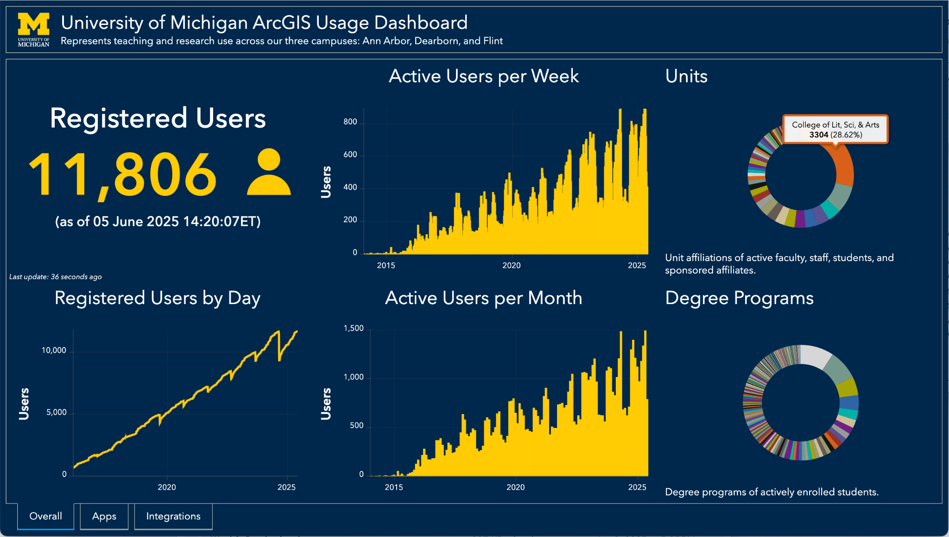

Slide 7
Goals for The Claremont Colleges Library's Dashboard:
Replicate the UMich Dashboard
Customize the Dashboard - improve workflow and show our user base divided by campus
Deploy & host the Dashboard

Slide 8
Modifying the Dashboard
Dealing with the REST (REpresentational State Transfer) API
Refactoring the Notebook
Secure(r) Credentials - YAML file
Data Export and Storage
Custom Visualization - User Base by Campus Affiliation

Slide 9
Wrangling the REST API
ArcGIS has two APIs (Application Program Interfaces) its users can access
Python developer API - "from arcgis.gis import GIS"
More built-in support
Shorter record of stored data (26 months)
REST API
Longer record of stored data (since Dec, 2018)
Requires use of requests/urllib modules, HTTP requests
REST has many parameters that can be explored

Slide 10
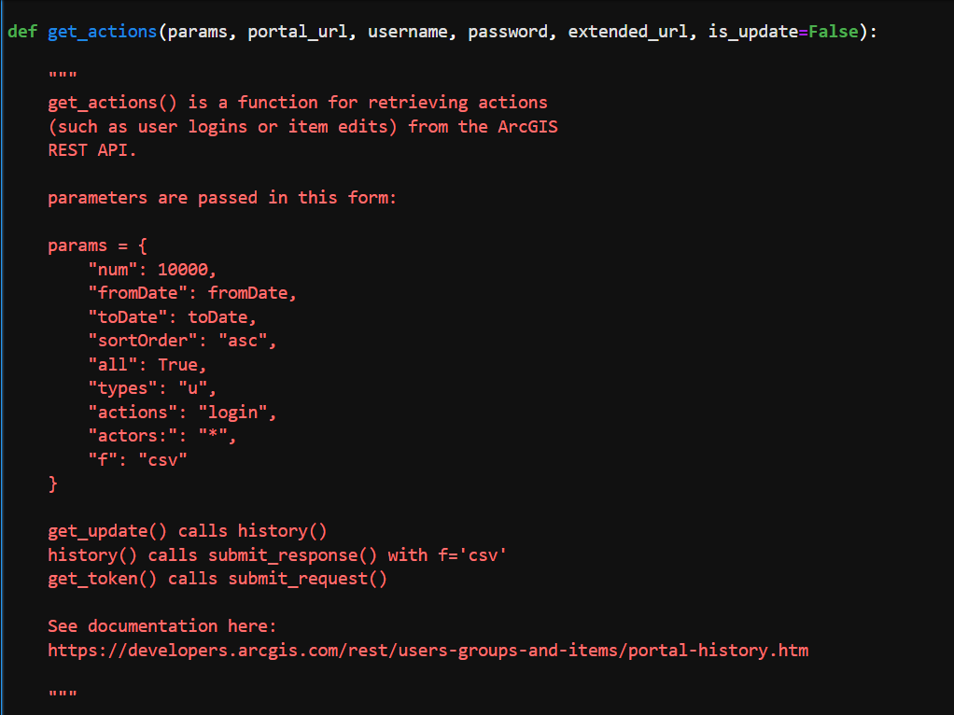
Refactoring the Notebook Code
Solved issue of expired tokens
Functions - reusable chunks of code, faster to edit - monthly vs. weekly logins, "get_actions()"
Tradeoff: functions add a layer of abstraction
Changed REST data type ("f" parameter) to .csv - 10000 records per query instead of 100 for JSON

Slide 11
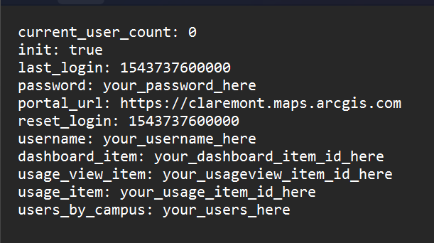
Credentials
urllib requires explicit "password", "username", and "portal_url" strings to access REST API.
More secure to pass credentials from a YAML file rather than put them directly into the script.

Slide 12

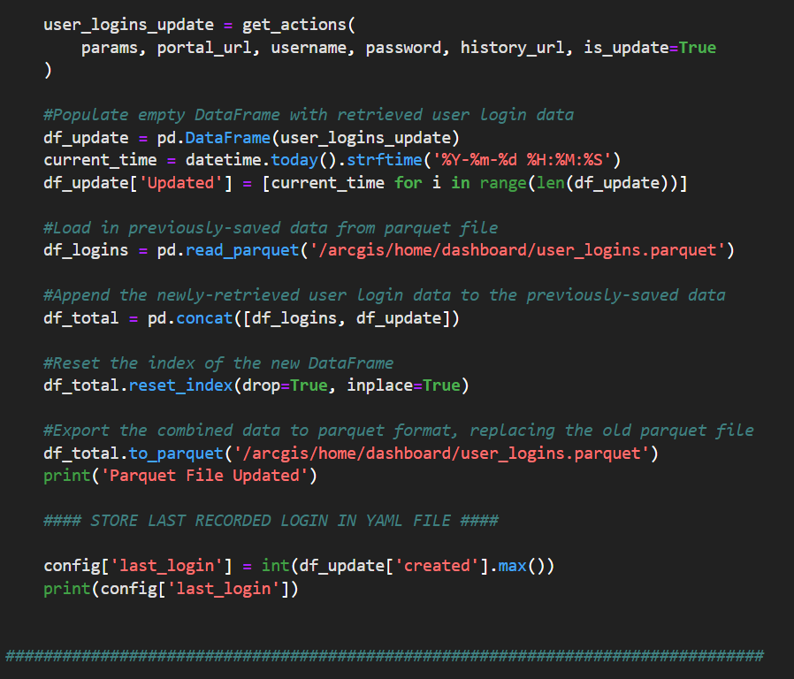
Storing the Data
Export data in Parquet file format
Better data fidelity than .csv
Smaller than JSON
Merge stored data with newly gathered data with pd.concat()

Slide 13
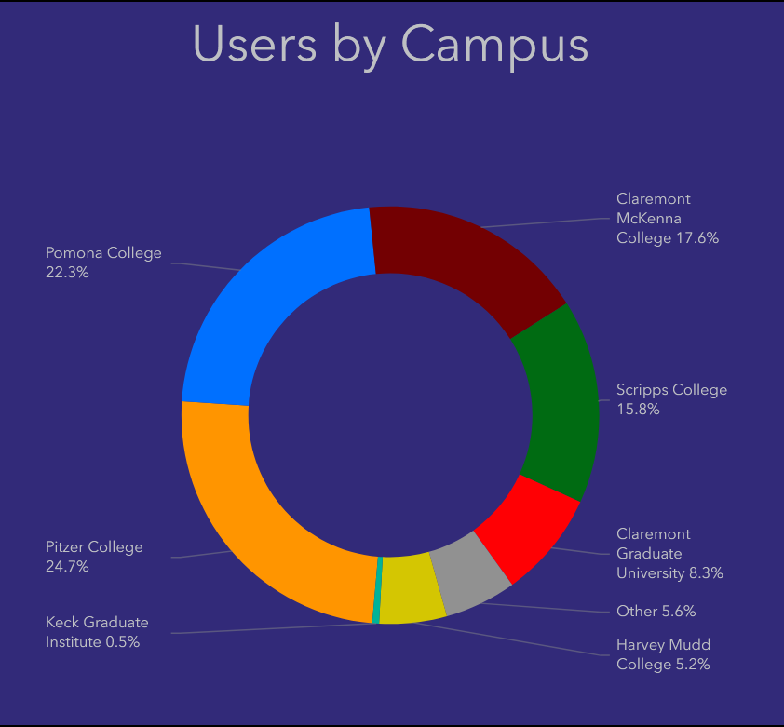
Custom Visualizations
The Claremont Colleges comprise seven academic institutions - we segmented our user base by using email domains - not perfect but good enough
Your mileage (and institutional needs) may vary!

Slide 14
Deploying the Dashboard
Hosting & Automation
Caveats for Hosted Jupyter Notebooks

Slide 15
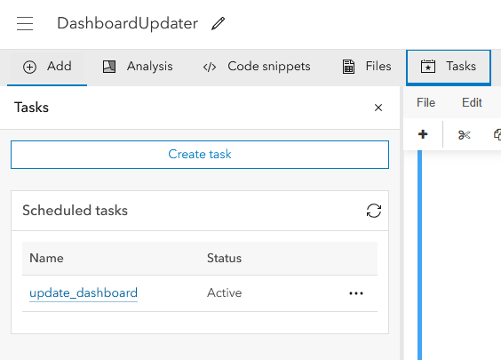
Automation - Hosted ArcGIS Jupyter Notebook
All in one platform - notebooks and data are hosted on institutional ArcGIS Online instance
Easy automation with "Tasks" feature

Slide 16
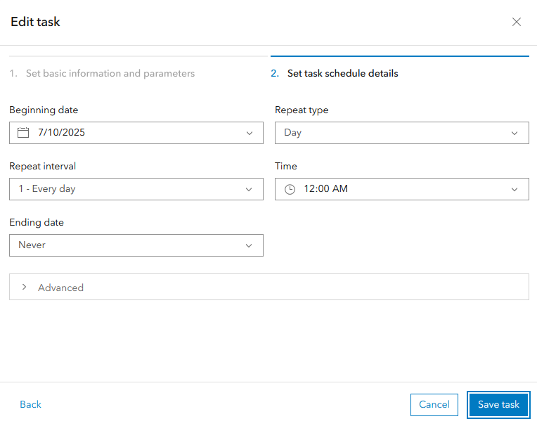
Tasks
Specify interval between once a month and every 15 minutes.
The entire notebook will run, and optionally update upon completion.

Slide 17
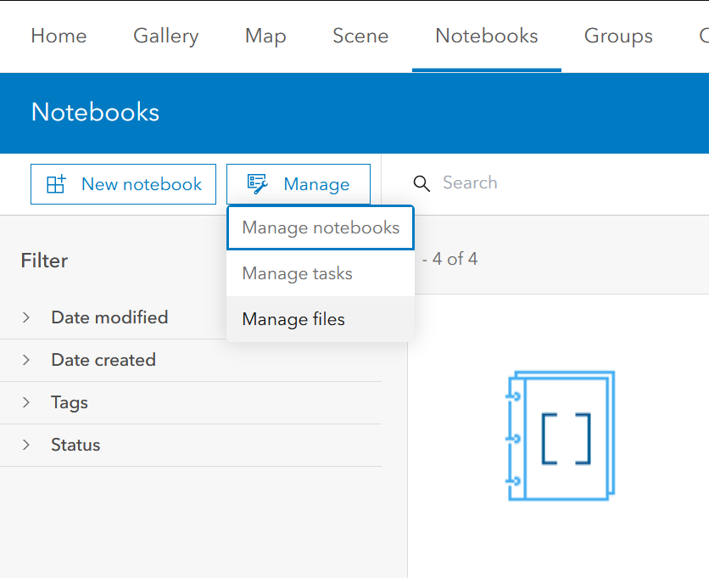
Platform-Specific Advice
ArcGIS Online
Hosted Notebooks:
THERE IS NO AUTOSAVE! Editing the script on a different platform is highly recommended!
No importing custom .py files, only officially published pypi modules via "pip install"
Navigating file storage is somewhat unintuitive
In script: /arcgis/home/[FOLDERNAME]/[FILENAME]

Slide 18
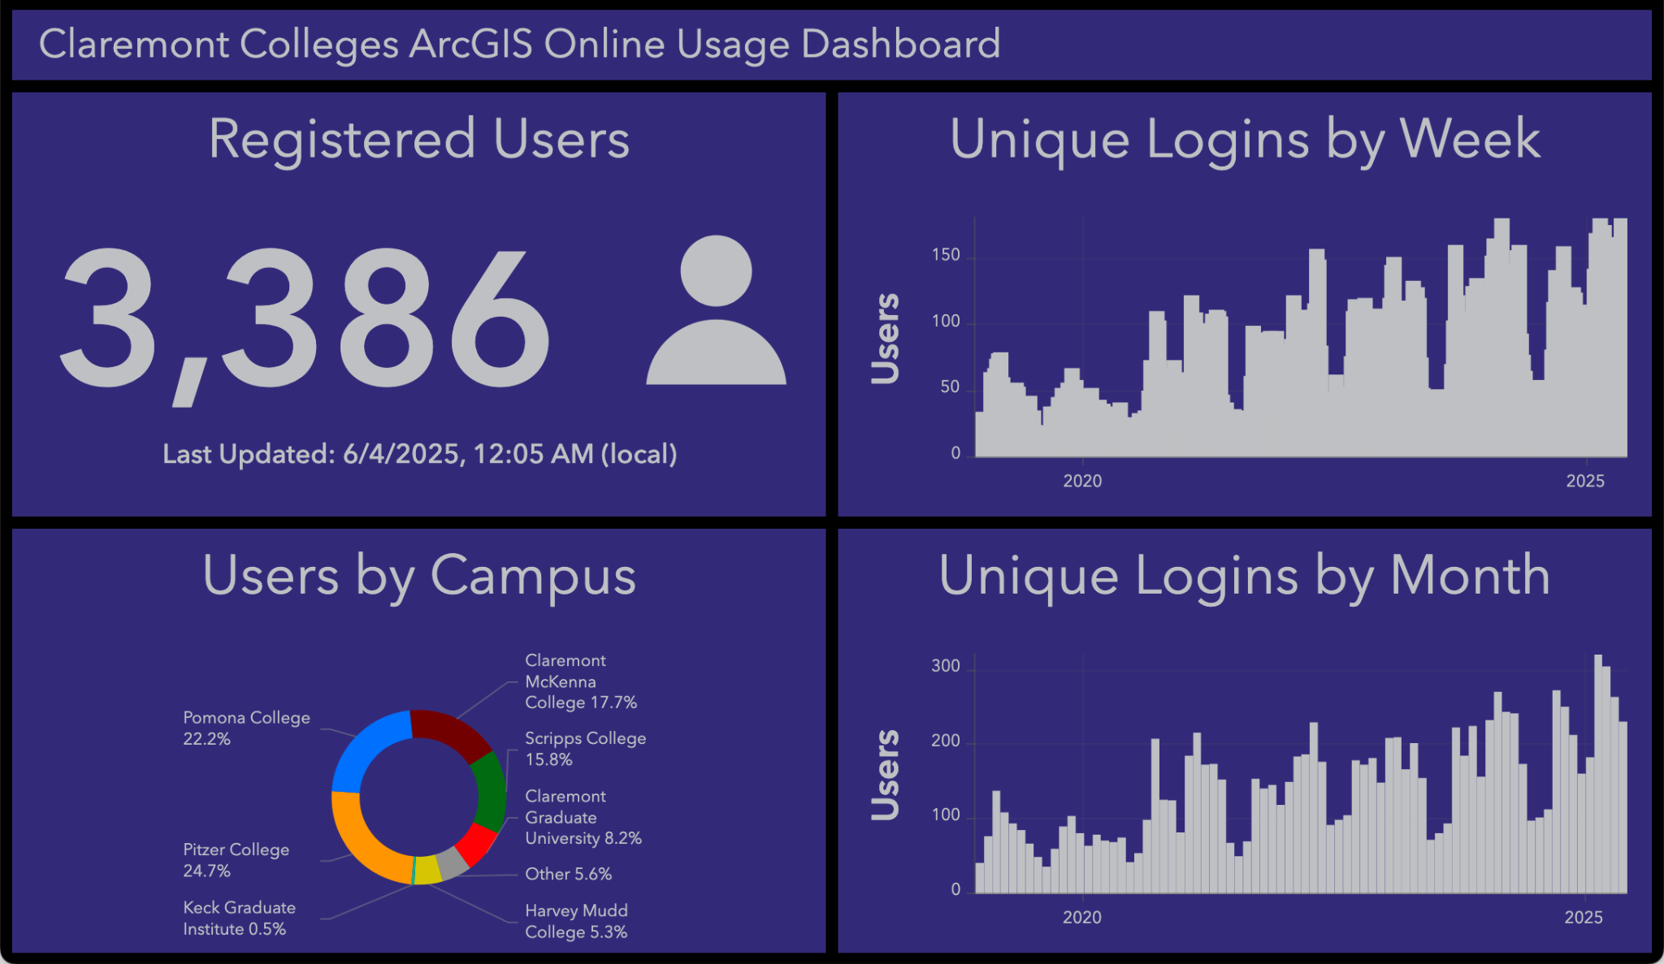

Slide 19
More Dashboard Examples:
University of Michigan
ArcGIS Item, Credit Use, and Data Storage Dashboards

Slide 20
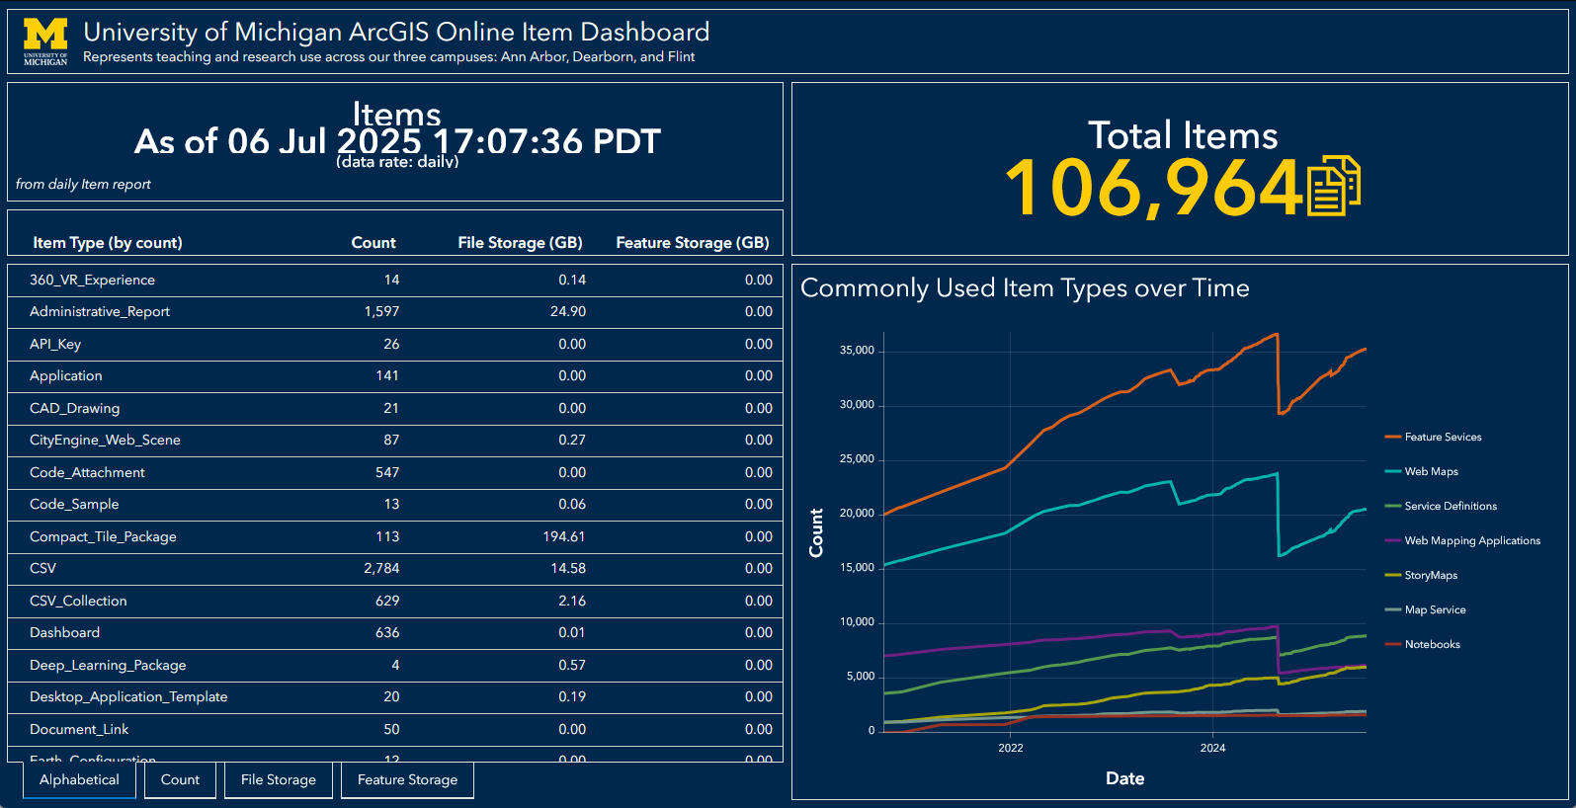

Slide 21
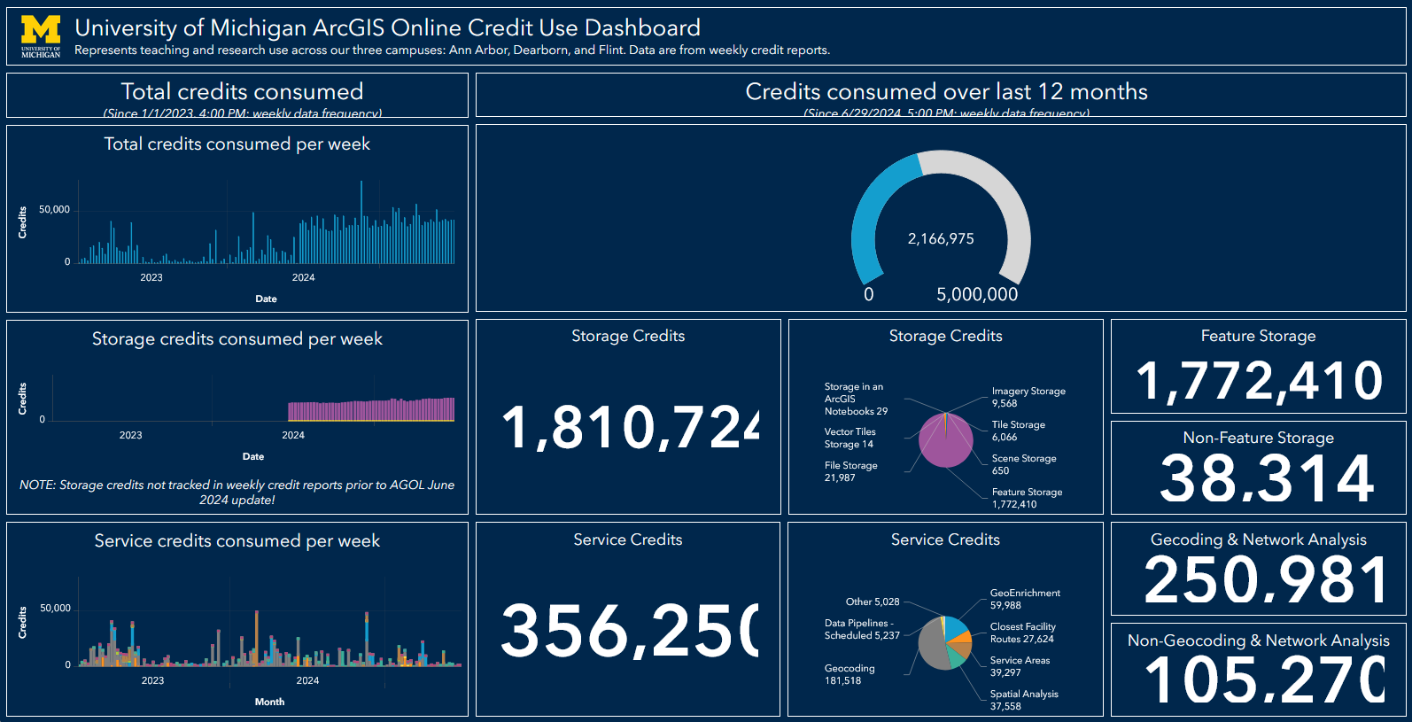

Slide 22
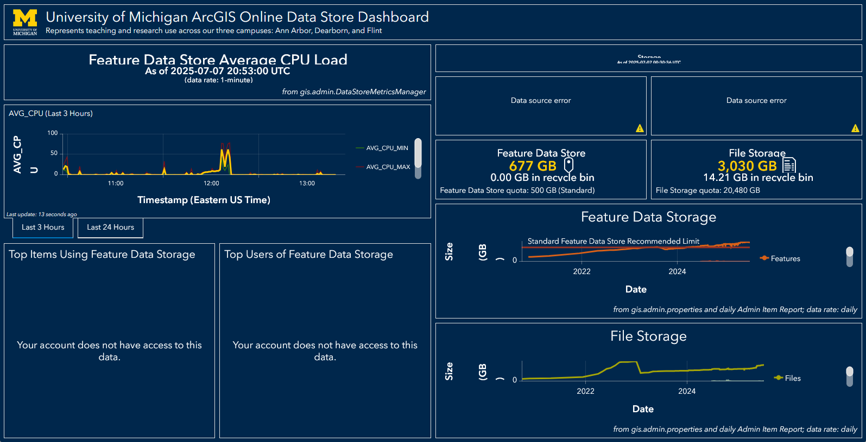

Slide 23
More Dashboard Examples:
Other Institutions
UC Davis
UC Merced
Penn State
University of Maryland

Slide 24
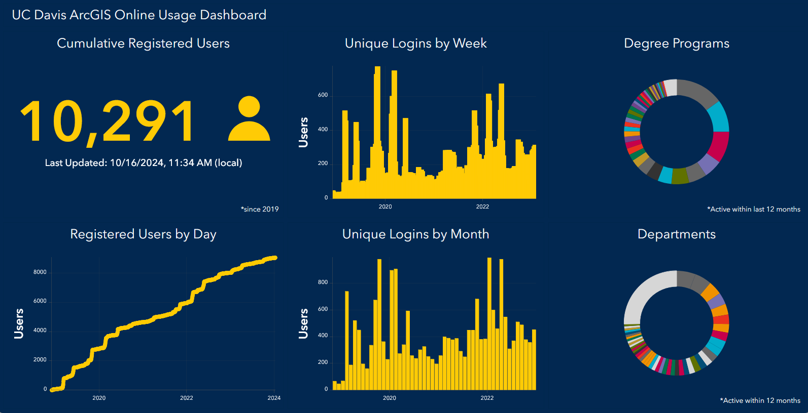

Slide 25
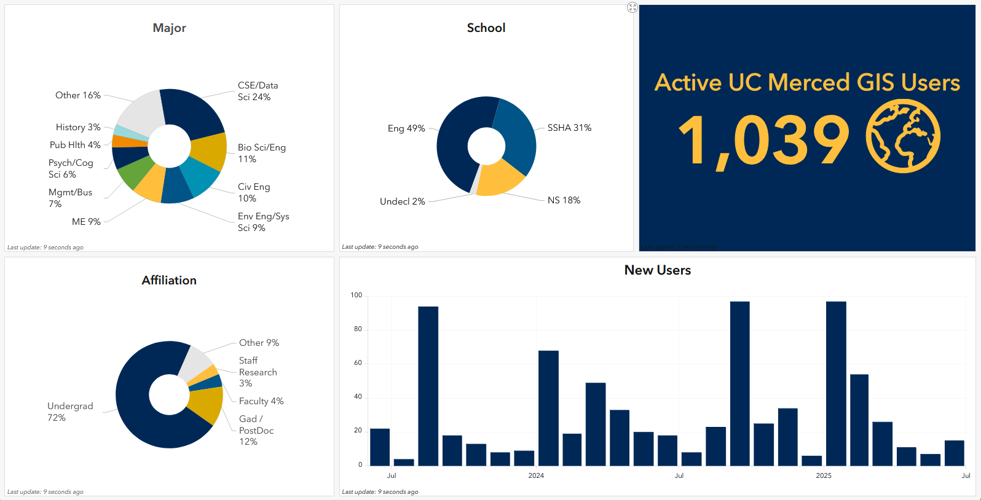

Slide 26
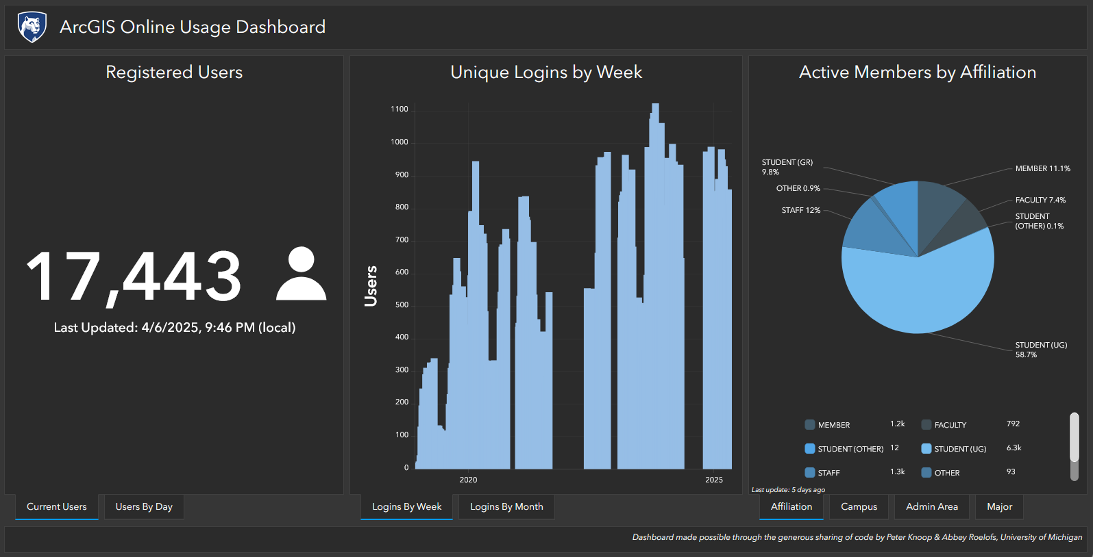

Slide 27
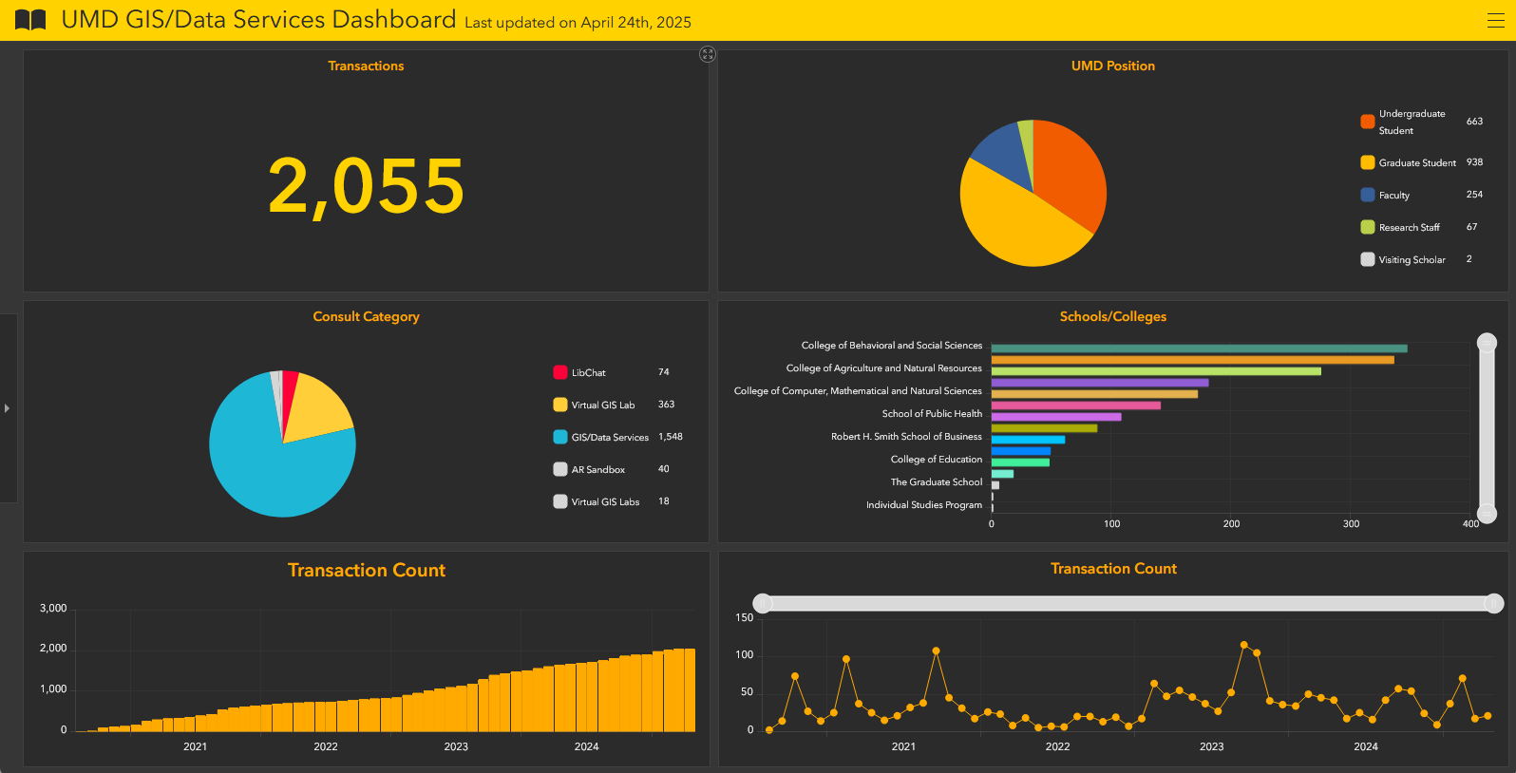

Slide 28

Questions and Answers/GitHub Repo for Dashboard
We welcome your input!
https://github.com/ClaremontCollegesLibrary/dashboard_public

